Slide 1
3D Basic & OpenGLES 2.0
thuy.vuthiminh@gameloft.com
phong.caothai@gameloft.com
khiem.tranthien@gameloft.com
tam.la@gameloft.com

Slide 2


Content
Introduction
Rendering pipeline
Basic knowledge in Opengles 2.0?
Shader
Basic GLSL-ES
Basic Math
MVP matrices
Textures
Obj model
Shader effect: Skydome using cube mapping

Slide 3
Content
Introduction
Rendering pipeline
Shader
Basic GLSL-ES
Basic Math
MVP matrices
Textures
Obj model
Shader effect: Skydome using cube mapping

Slide 4
Basic Math
Point
Vector
Matrix
Transformation (affine)
Homogeneous coordinate
Combination transformation
Basic Math concept

Slide 5
Basic Math
Point
Vector
Matrix
Transformation (affine)
Homogeneous coordinate
Combination transformation
Basic Math concept

Slide 6

Point
Position of a point P(px, py, pz)
Right – hand coordination system
$$P= \left[\begin{aligned}Px \\ Py \\ Pz\end{aligned}\right]$$
y
Pratice:
Draw point P(5, 3, 4)
in Opengl coordination system
P (4, 2, -3)
2
-3
4
x
z

Slide 7
Basic Math
Point
Vector
Matrix
Transformation (affine)
Homogeneous coordinate
Combination transformation
Basic Math concept

Slide 8
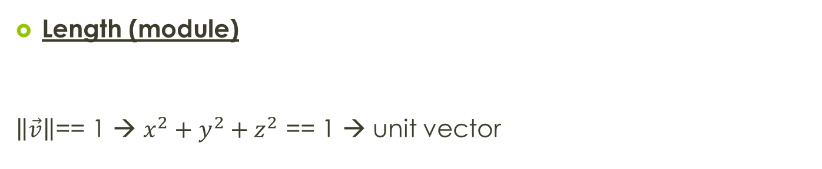
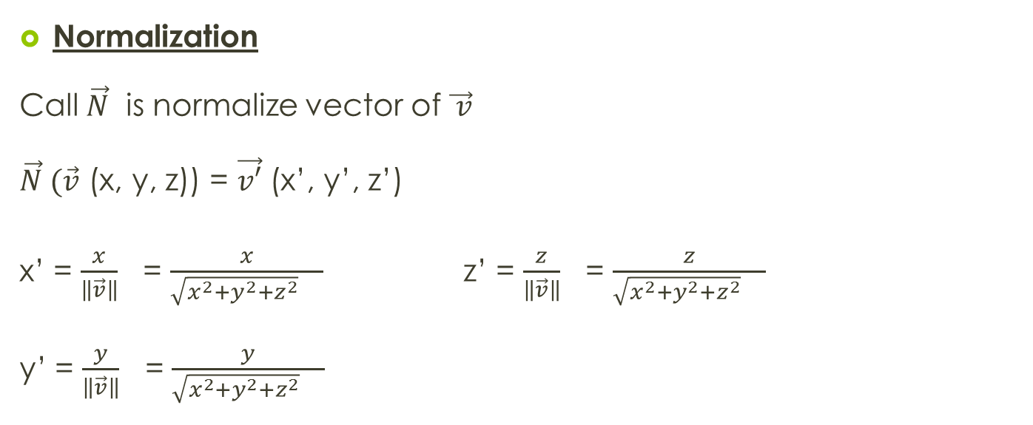

Vector
Length (module)
$\left\|\vec{v}\right\|$== 1 → $x^{2}+{y^{2}+z}^{2}$ == 1 → unit vector
$\left\|\vec{v}\right\|$ = $\sqrt{x^{2}+{y^{2}+z}^{2}}$
Normalization
Call $\vec{N}$ is normalize vector of $\vec{ v}$
$\vec{N} (\vec{v}$ (x, y, z)) = $\vec{v′}$ (x’, y’, z’)
x’ = $\frac{x}{\left\|\vec{v}\right\|}$ = $\frac{x}{\sqrt{x^{2}+{y^{2}+z}^{2}} }$ z’ = $\frac{z}{\left\|\vec{v}\right\|}$ = $\frac{z}{\sqrt{x^{2}+{y^{2}+z}^{2}} }$
y’ = $\frac{y}{\left\|\vec{v}\right\|}$ = $\frac{y}{\sqrt{x^{2}+{y^{2}+z}^{2}} }$
Notes:
Length(module): độ dài
Normalization: chuẩn hóa một vector, bằng từng tọa độ của vector đó theo x, y, z chia cho độ dài của chính nó

Slide 9

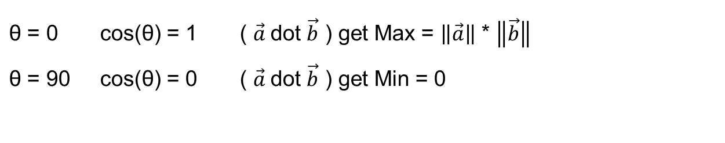

Vector: Dot Product
Dot product
$\vec{a}$dot $\vec{b}$= $\left\|\vec{a}\right\|$ * $\left\|\vec{b}\right\|$* cos(θ)
$\left\|\vec{a}\right\|$ = 1
$\left\|\vec{b}\right\|$ = 1
Result is a scalar
Implement:
$\vec{a} \left(a1, a2, a3\right)$ dot $\vec{b}(b1, b2, b3)$ = a1*b1 + a2*b2 + a3*b3
$\vec{a}$dot $\vec{b}$ = cos(θ)
θ = 0 cos(θ) = 1 ( $\vec{a}$dot $\vec{b}$ ) get Max = $\left\|\vec{a}\right\|$ * $\left\|\vec{b}\right\|$ θ = 90 cos(θ) = 0 ( $\vec{a}$dot $\vec{b}$ ) get Min = 0
Notes:
Dot product: tích vô hướng. Tích vô hướng ở đây được trình bày theo 2 cách:
Ý nghĩa hình học = module(a) * module (b) * cos (góc tạo bởi 2 vector đó)
Ý nghĩa toán học: công thức dùng để tính toán trong thực tế, vì cos mang sai số rất lớn:
http://vi.wikipedia.org/wiki/H%C3%A0m_l%C6%B0%E1%BB%A3ng_gi%C3%A1c

Slide 10
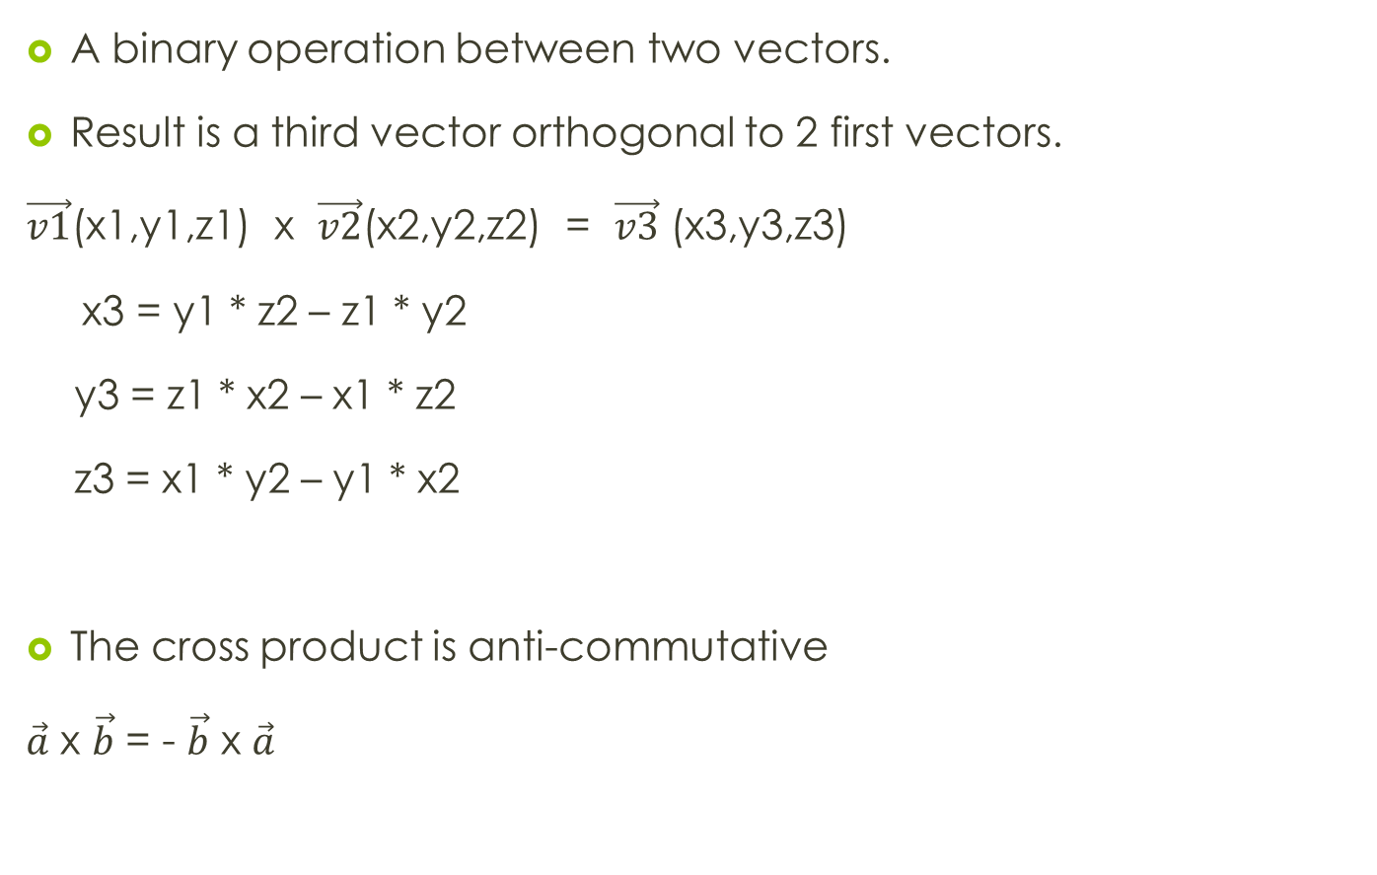



Vector: Cross Product
A binary operation between two vectors.
Result is a third vector orthogonal to 2 first vectors.
$\vec{v1}$(x1,y1,z1) x $\vec{v2}$(x2,y2,z2) = $\vec{v3}$ (x3,y3,z3)
x3 = y1 * z2 – z1 * y2
y3 = z1 * x2 – x1 * z2
z3 = x1 * y2 – y1 * x2
The cross product is anti-commutative
$\vec{a}$ x $\vec{b}$ = - $\vec{b}$ x $\vec{a}$
$$\vec{n}$$
$$\vec{v}$$
$$\vec{u}$$
Notes:
Tích có hướng
Tích có hướng mang tính chất giao hoán ngược

Slide 11

Practice 5.1
Assume
$\vec{v1}$(5, -1, 7) and $\vec{v2}$(4, 2, 3)
Calc $\vec{v3}$ = $\vec{v1 }$x$\vec{ v2}$
Result?
Result:
X3 = -17
Y3 = 13
Z3 = 14

Slide 12
Basic Math
Point
Vector
Matrix
Transformation (affine)
Homogeneous coordinate
Combination transformation
Basic Math concept

Slide 13
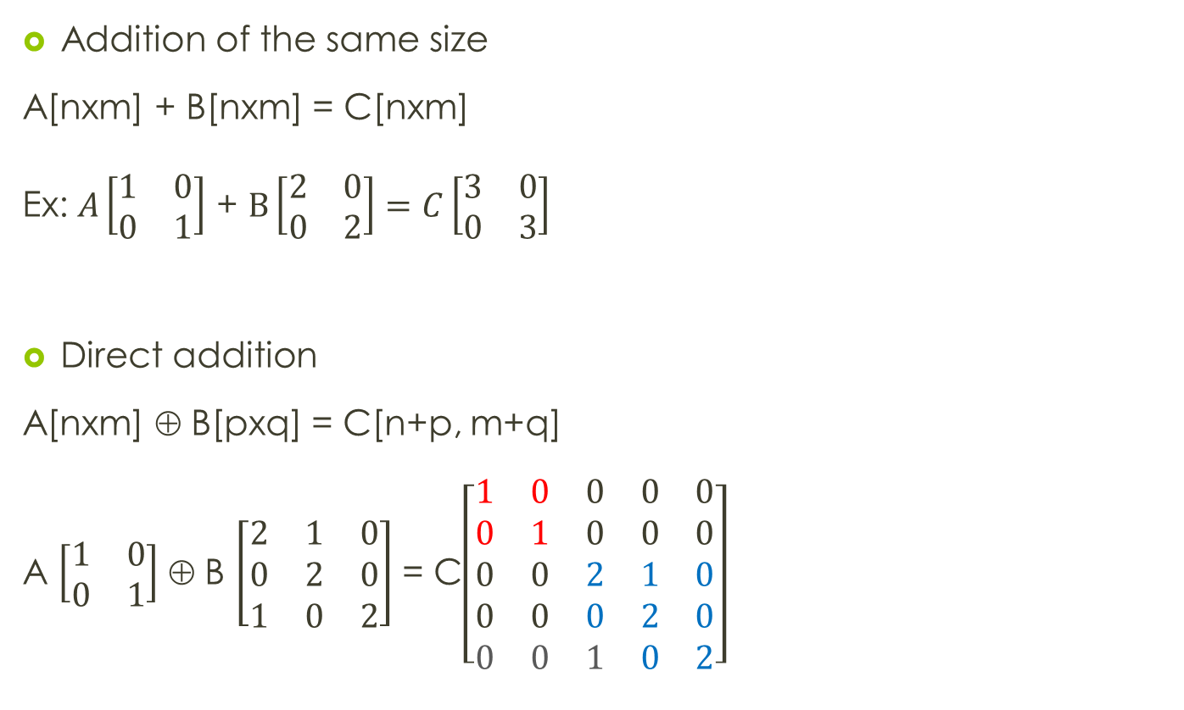
Matrix: Addition & Multiplication
Addition of the same size
A[nxm] + B[nxm] = C[nxm]
Ex: $A\left[\begin{matrix}1 & 0 \\ 0 & 1\end{matrix}\right]$ + $B\left[\begin{matrix}2 & 0 \\ 0 & 2\end{matrix}\right]=C\left[\begin{matrix}3 & 0 \\ 0 & 3\end{matrix}\right]$
Direct addition
A[nxm] ⊕ B[pxq] = C[n+p, m+q]
A $\left[\begin{matrix}1 & 0 \\ 0 & 1\end{matrix}\right]$ ⊕ B $\left[\begin{matrix}2 & 1 & 0 \\ 0 & 2 & 0 \\ 1 & 0 & 2\end{matrix}\right]$ = C$\left[\begin{matrix}1 & 0 & 0 & 0 & 0 \\ 0 & 1 & 0 & 0 & 0 \\ 0 & 0 & 2 & 1 & 0 \\ 0 & 0 & 0 & 2 & 0 \\ 0 & 0 & 1 & 0 & 2\end{matrix}\right]$
Notes:
Công và nhân 2 tra trận
Đối với phép công ta có 2 loại:
Công cùng kích thước
Cộng trực tiếp (direct addition)

Slide 14
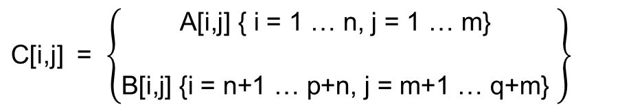

Matrix: Addition & Multiplication (conts)
Direct addition
Multiplication
A * B = C ; Cij=$\sum_{1}^{n}{A_{ik}}$x$B_{kj}$
C[i,j] = $\left\{\begin{aligned}\text{A}\text{[}\text{i}\text{,}\text{j}\text{] \{ }\text{i}\text{ = 1 … }\text{n}\text{, }\text{j}\text{ = 1 … }\text{m}\text{\} } \\ \\ \text{B}\text{[}\text{i}\text{,}\text{j}\text{] \{}\text{i}\text{ = }\text{n}\text{+1}\text{ … }\text{p}\text{+}\text{n}\text{, }\text{j}\text{ = }\text{m}\text{+1}\text{ … }\text{q}\text{+}\text{m}\text{\} }\end{aligned}\right\}$

Slide 15

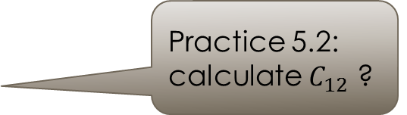
Matrix: Minor & Cofactor
Minor $M_{ij}$ = $\left|\begin{matrix} & ⋯ &  \\ ⋯ & x & y \\  & z & w\end{matrix}\right|$ = (x*w – z*y) Cofactor${ C}_{ij}$ = ${(−1)}^{i+j } ∗ M_{ij}={(−1)}^{i+j }\left|\begin{matrix} & ⋯ &  \\ ⋯ & x & y \\  & z & w\end{matrix}\right|$ = ${(−1)}^{i+j }$(x*w – z*y) A = $\left(\begin{matrix}1 & 4 & 7 \\ 3 & 0 & 5 \\ −1 & 9 & 11\end{matrix}\right)$
$C_{23}$ = ${(−1)}^{2+3}$ $\left|\begin{matrix}1 & 4 &  \\  &  &  \\ −1 & 9 & \end{matrix}\right|$ = (-1) * (9 – (-4)) = -13
Result: -38
Practice 5.2: calculate $C_{12}$ ?
Notes:
Minor: kết quả là một số, là khái niệm dùng để tính định thức của ma trận (minor ko phải định thức)
Confactor: là kết quả của minor nhưng có thêm hệ số dòng cột

Slide 16
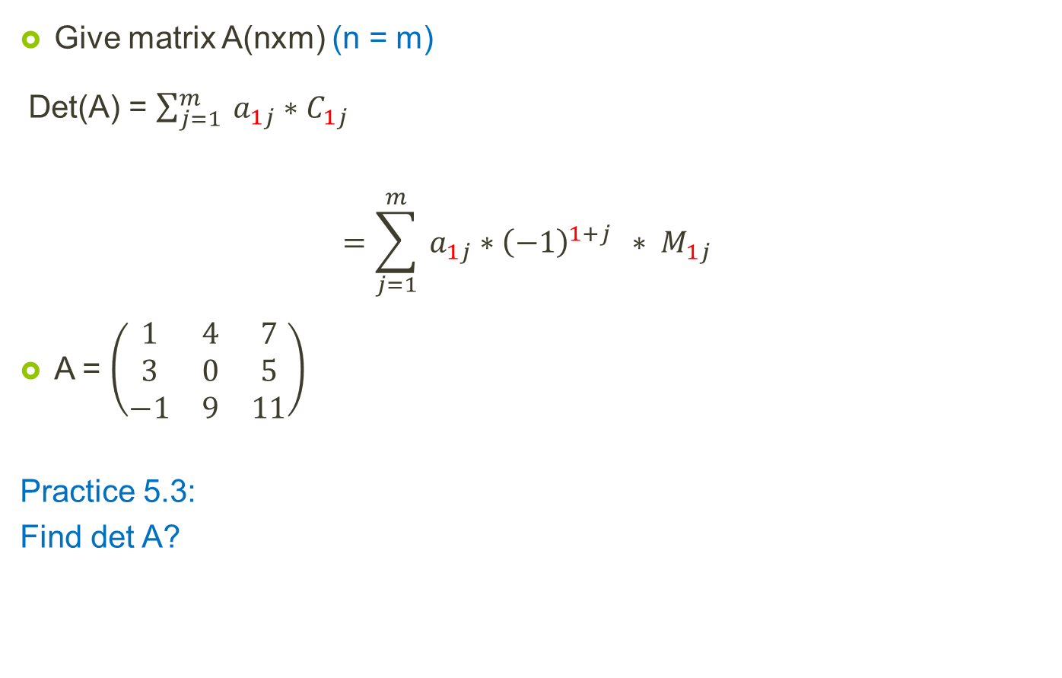

Matrix: Determinant
Give matrix A(nxm) (n = m)
Det(A) = $\sum_{j=1}^{m}{{ a}_{1j}}∗C_{1j}$
$$=\sum_{j=1}^{m}{{ a}_{1j}}∗{\left(−1\right)}^{1+j } ∗ M_{1j}$$
A = $\left(\begin{matrix}1 & 4 & 7 \\ 3 & 0 & 5 \\ −1 & 9 & 11\end{matrix}\right)$
Practice 5.3:
Find det A?
Result:
Det(A) = 1 * $M_{11}$ - 4 * $M_{12}$ + 7 * $M_{13}$
= 1* (-45) – 4*38 + 7*27 = -8
Notes:
Determinant: định thức, trong slide này chỉ trình bày phần định thức được tính theo hệ số Confactor của dòng đầu tiên của một ma trân.
(Đây chính là công thức Leibniz)
Ngoài ra cũng có thể dùng công thức Laplace hay phép khử Gauss, tham khảo tại đây:
http://vi.wikipedia.org/wiki/%C4%90%E1%BB%8Bnh_th%E1%BB%A9c

Slide 17

Matrix: Transpose
Give A(n$xm) \left[\begin{matrix}{ a}_{11} & { a}_{12} & { a}_{1m} \\ { a}_{21} &  &  \\ ⋮ & ⋱ & ⋮ \\ { a}_{n1} & ⋯ & { a}_{nm}\end{matrix}\right]$
$A^{t}$ is transpose of A $↔$ $A^{t}$(mxn) $\left[\begin{matrix}{ a}_{11} & { a}_{21} & { a}_{n1} \\ { a}_{12} &  &  \\ ⋮ & ⋱ & ⋮ \\ { a}_{1m} & ⋯ & { a}_{nm}\end{matrix}\right]$
Ex:
A(3x4) $\left[\begin{matrix}1 & 1 & 1 & 1 \\ 0 & 2 & 1 & 0 \\ 0 & 0 & 3 & 4\end{matrix}\right] → A^{t}(4x3)= \left[\begin{matrix}1 & 0 & 0 \\ 1 & 2 & 0 \\ 1 & 1 & 3 \\ 1 & 0 & 4\end{matrix}\right]$
Notes:
Transpose: chuyển vị của 1 ma trận

Slide 18

Matrix: Diagonal Matrix & Identity Matrix
B is diagonal matrix means:
B = $\left[\begin{matrix}{ b}_{11} & 0 & 0 & 0 \\ 0 & { b}_{22} & 0 & 0 \\ 0 & 0 & ⋱ & 0 \\ 0 & 0 & 0 & { b}_{nn}\end{matrix}\right]$
$${ b}_{ii}=1 →Identity Matrix I= \left[\begin{matrix}1 & 0 & 0 & 0 \\ 0 & 1 & 0 & 0 \\ 0 & 0 & 1 & 0 \\ 0 & 0 & 0 & 1\end{matrix}\right]$$
Notes:
Ma trận đường chéo và ma trận đơn vị.

Slide 19
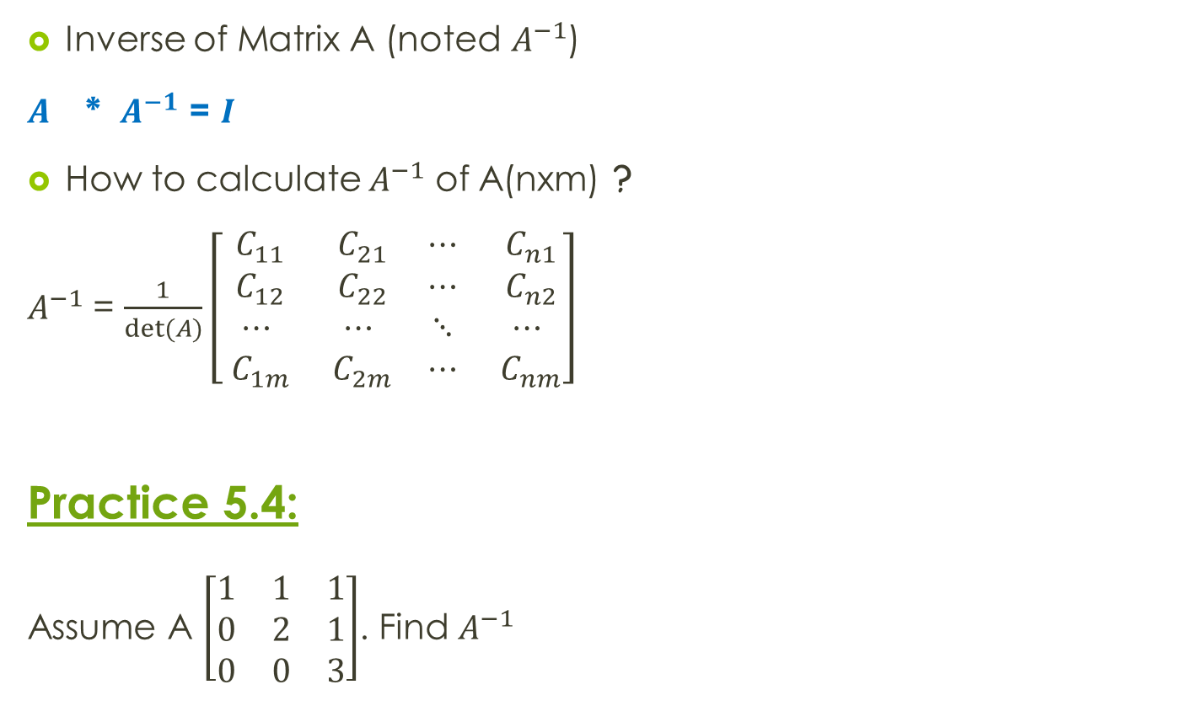
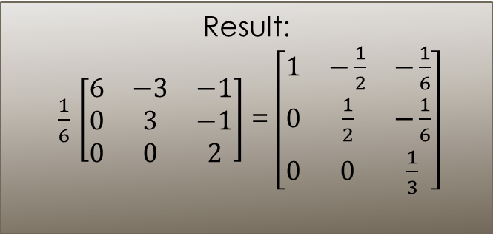
Matrix: Inverse of a Matrix
Inverse of Matrix A (noted $A^{−1}$)
$A^{}$ * $A^{−1}$ = $I$
How to calculate $A^{−1}$ of A(nxm) ?
$A^{−1}$ = $\frac{1}{det⁡(A)}\left[\begin{matrix}{ C}_{11} & { C}_{21} & ⋯ & { C}_{n1} \\ { C}_{12} & { C}_{22} & ⋯ & { C}_{n2} \\ ⋯ & ⋯ & ⋱ & ⋯ \\ { C}_{1m} & { C}_{2m} & ⋯ & { C}_{nm}\end{matrix}\right]$
Practice 5.4:
Assume A $\left[\begin{matrix}1 & 1 & 1 \\ 0 & 2 & 1 \\ 0 & 0 & 3\end{matrix}\right]$. Find $A^{−1}$
Result:
$\frac{1}{6}$ $\left[\begin{matrix}6 & −3 & −1 \\ 0 & 3 & −1 \\ 0 & 0 & 2\end{matrix}\right]$ = $\left[\begin{matrix}1 & −\frac{1}{2} & −\frac{1}{6} \\ 0 & \frac{1}{2} & −\frac{1}{6} \\ 0 & 0 & \frac{1}{3}\end{matrix}\right]$
Notes:
Nghịch đảo của 1 ma trận, chỉ áp dụng cho ma trận vuông.

Slide 20
Basic Math
Point
Vector
Matrix
Transformation (affine)
Homogeneous coordinate
Combination transformation
Basic Math concept

Slide 21
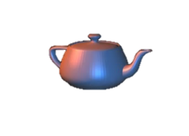

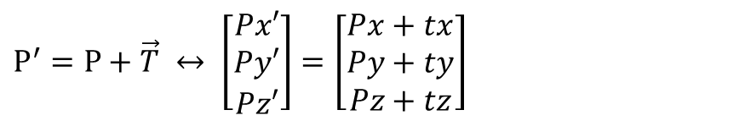


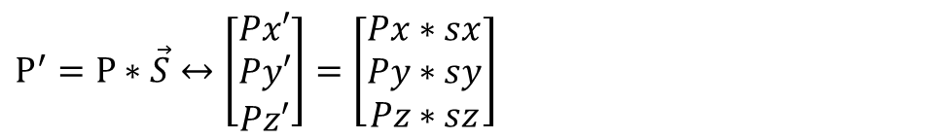
Transformation: Translate, Scale
Translate operator:
Scale Operator
$P^{′}=P+\vec{T} ↔ \left[\begin{aligned}Px′ \\ Py′ \\ Pz′\end{aligned}\right]=$ $\left[\begin{aligned}Px+tx \\ Py+ty \\ Pz+tz\end{aligned}\right]$
P
P’
$$\vec{T}$$
$P^{′}=P∗\vec{S}↔\left[\begin{aligned}Px′ \\ Py′ \\ Pz′\end{aligned}\right]=$ $\left[\begin{aligned}Px∗sx \\ Py∗sy \\ Pz∗sz\end{aligned}\right]$
$$\vec{S}$$
Notes:
Tịnh tiến và tỉ lệ

Slide 22






Transformation: Rotate operator
§ Principle axis § Arbitrary axis
y
y
$$\vec{V}$$
P’
$$θ$$
P
$$\vec{T}$$
+
+
$$R_{x}(α)$$
+
x
x
$$R_{y}(γ)$$
z
z
Axis | Positive angle
Oz | X → y
Oy | Z → x
Ox | Y → z
How to rotate in an arbitrary axis?
R($θ$) = $T^{−1} . {R_{x}}_{}^{−1}$. ${R_{y}}_{}^{−1}.R_{x}\text{.}R_{y}$. $R_{x}$. $T_{}$
Notes:
Phép xoay: bao gồm 2 cách: xoay quanh trục chính tắc (ox, oy, oz) và xoay quanh trục bất kì

Slide 23
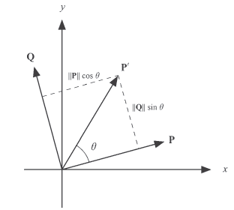
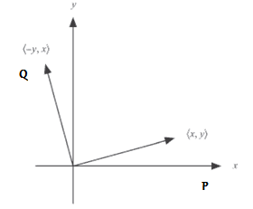
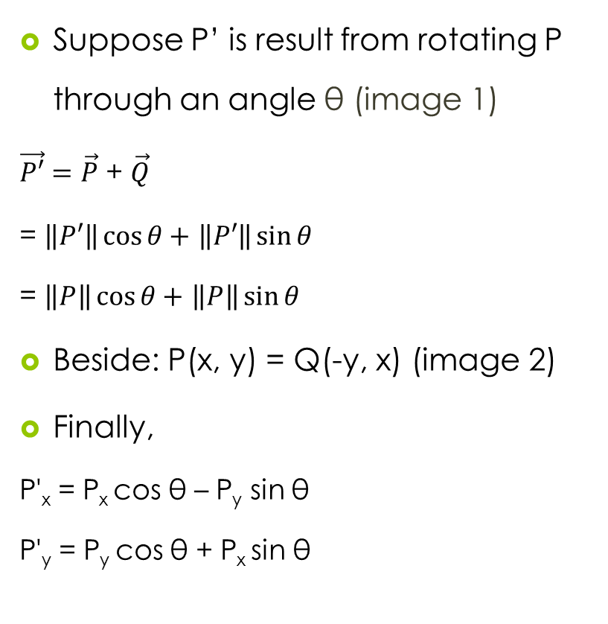
Transformation: Principle Rotate
Suppose P’ is result from rotating P through an angle θ (image 1)
$\vec{P′}=\vec{P}$ + $\vec{Q}$
= $\left\|P′\right\|\cos{θ}+$ $\left\|P′\right\|\sin{θ}$
= $\left\|P\right\|\cos{θ}+$ $\left\|P\right\|\sin{θ}$
Beside: P(x, y) = Q(-y, x) (image 2)
Finally,
P'_{x} = P_{x} cos θ – P_{y} sin θ
P'_{y} = P_{y} cos θ + P_{x} sin θ
Image 1: P' as a linear combination of P and Q
Image 2 : Rotation by 90 degrees in the x-y plane

Slide 24
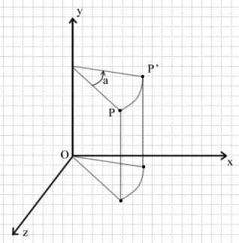
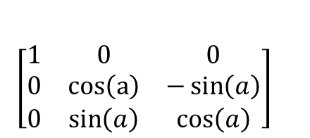
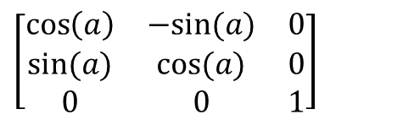
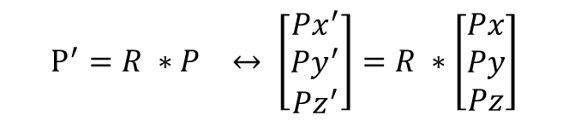
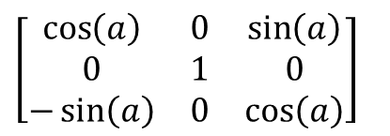
Transformation: Principle Rotate
With R is a matrix:
Ox
Oy
Oz
$\left[\begin{matrix}1 & 0 & 0 \\ 0 & \cos\left(a\right) & −\sin\left(a\right) \\ 0 & \sin\left(a\right) & \cos\left(a\right)\end{matrix}\right]$
$$\left[\begin{matrix}\cos\left(a\right) & 0 & \sin\left(a\right) \\ 0 & 1 & 0 \\ −\sin\left(a\right) & 0 & \cos\left(a\right)\end{matrix}\right]$$
$$P^{′}={R ∗P}_{}↔ \left[\begin{aligned}Px^{′} \\ Py^{′} \\ Pz^{′}\end{aligned}\right]=R ∗\left[\begin{aligned}Px \\ Py \\ Pz\end{aligned}\right]$$
$$\left[\begin{matrix}\cos\left(a\right) & −sin⁡(a) & 0 \\ sin⁡(a) & cos⁡(a) & 0 \\ 0 & 0 & 1\end{matrix}\right]$$
Notes:
Phép xoay chính tắc

Slide 25
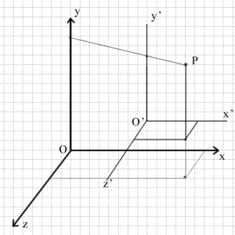
Transformation: Coordination transformation
2 kinds of transformation:
Objects
Coordination
Coordinate transformation is an invertible affine transformation
Notes:
Phép biến đổi hệ trục tọa độ (coordination transformation)

Slide 26
Basic Math
Point
Vector
Matrix
Transformation (affine)
Homogeneous coordinate
Combination transformation
Basic Math concept

Slide 27
Homogeneous coordinate
Why need homogeneous coordinate?
Use both ”add” and “multiply” operator!
To unique operator → Homogeneous coordinate
Notes:
Hệ tọa độ thuần nhất

Slide 28





Homogeneous coordinate (conts)
$$\left[\begin{aligned}Px \\ Py \\ Pz \\ Pw\end{aligned}\right]$$
Point or vector
§ For point pw != 0 § For vector pw = 0
Pw = 1
If (Pw != 1), divide to Pw
$$\left[\begin{aligned}Px \\ Py \\ Pz \\ Pw\end{aligned}\right]$$
$$\left[\begin{aligned}Px \\ Py \\ Pz \\ 0\end{aligned}\right]$$
$$\left[\begin{aligned}Px/Pw \\ Py/Pw \\ Pz/Pw \\ Pw/Pw\end{aligned}\right]$$
$$\left[\begin{aligned}Px/Pw \\ Py/Pw \\ Pz/Pw \\ 1\end{aligned}\right]$$

Slide 29
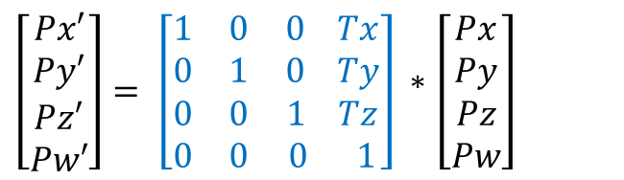
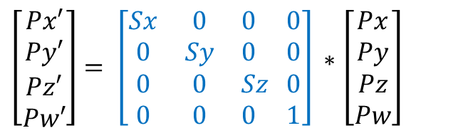
Homogeneous coordinate: Translate & Scale
P’ = M * P
Translate
Scale
$\left[\begin{aligned}Px′ \\ Py′ \\ Pz′ \\ Pw′\end{aligned}\right]$ $= \left[\begin{matrix}1 & 0 & 0 Tx \\ 0 & 1 & 0 Ty \\ \begin{aligned}0 \\ 0\end{aligned} & \begin{aligned}0 \\ 0\end{aligned} & \begin{aligned}1 Tz \\ 0 1\end{aligned}\end{matrix}\right]$* $\left[\begin{aligned}Px \\ Py \\ Pz \\ Pw\end{aligned}\right]$
$\left[\begin{aligned}Px′ \\ Py′ \\ Pz′ \\ Pw′\end{aligned}\right]$ $= \left[\begin{matrix}Sx & 0 & 0 0 \\ 0 & Sy & 0 0 \\ \begin{aligned}0 \\ 0\end{aligned} & \begin{aligned}0 \\ 0\end{aligned} & \begin{aligned}Sz 0 \\ 0 1\end{aligned}\end{matrix}\right]$* $\left[\begin{aligned}Px \\ Py \\ Pz \\ Pw\end{aligned}\right]$
Notes:
Ma trận tịnh tiến, tỉ lệ trong hệ tọa độ thuần nhất.

Slide 30
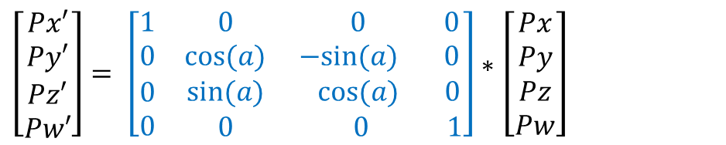
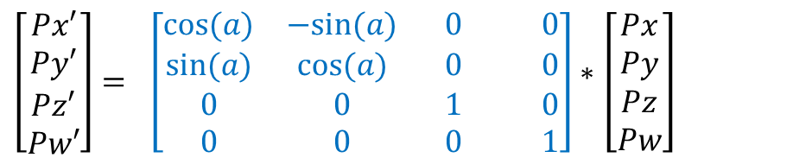
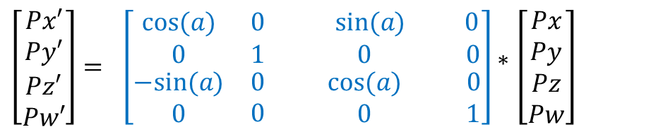
Homogeneous coordinate: Rotate
P’ = M * P
Ox
Oy
Oz
$\left[\begin{aligned}Px′ \\ Py′ \\ Pz′ \\ Pw′\end{aligned}\right]$ $= \left[\begin{matrix}1 & 0 & 0 0 \\ 0 & cos⁡(a) & −sin⁡(a) 0 \\ \begin{aligned}0 \\ 0\end{aligned} & \begin{aligned}sin⁡(a) \\ 0\end{aligned} & \begin{aligned} cos⁡(a) 0 \\ 0 1\end{aligned}\end{matrix}\right]$* $\left[\begin{aligned}Px \\ Py \\ Pz \\ Pw\end{aligned}\right]$
$\left[\begin{aligned}Px′ \\ Py′ \\ Pz′ \\ Pw′\end{aligned}\right]$ $= \left[\begin{matrix}cos⁡(a) & 0 & sin⁡(a) 0 \\ 0 & 1 & 0 0 \\ \begin{aligned}−sin⁡(a) \\ 0\end{aligned} & \begin{aligned}0 \\ 0\end{aligned} & \begin{aligned} cos⁡(a) 0 \\ 0 1\end{aligned}\end{matrix}\right]$* $\left[\begin{aligned}Px \\ Py \\ Pz \\ Pw\end{aligned}\right]$
$\left[\begin{aligned}Px′ \\ Py′ \\ Pz′ \\ Pw′\end{aligned}\right]$ $= \left[\begin{matrix}cos⁡(a) & −sin⁡(a) & 0 0 \\ sin⁡(a) & cos⁡(a) & 0 0 \\ \begin{aligned}0 \\ 0\end{aligned} & \begin{aligned}0 \\ 0\end{aligned} & \begin{aligned} 1 0 \\ 0 1\end{aligned}\end{matrix}\right]$* $\left[\begin{aligned}Px \\ Py \\ Pz \\ Pw\end{aligned}\right]$
Notes:
Ma trận xoay trong hệ tọa độ thuần nhất.

Slide 31

Practice 5.5
Assume that P(10, -7, 6). Find P’ by
Moving along T(-1, 4, 6)
Scaling S(0.5, 1, 1.5)
Rotate around Ox ${90}^{o}$
Answer?
P’(9, -3, 12)
P’(5, -7, 9)
P’(10, -6, -7)

Slide 32
Basic Math
Point
Vector
Matrix
Transformation (affine)
Homogeneous coordinate
Combination transformation
Basic Math concept

Slide 33
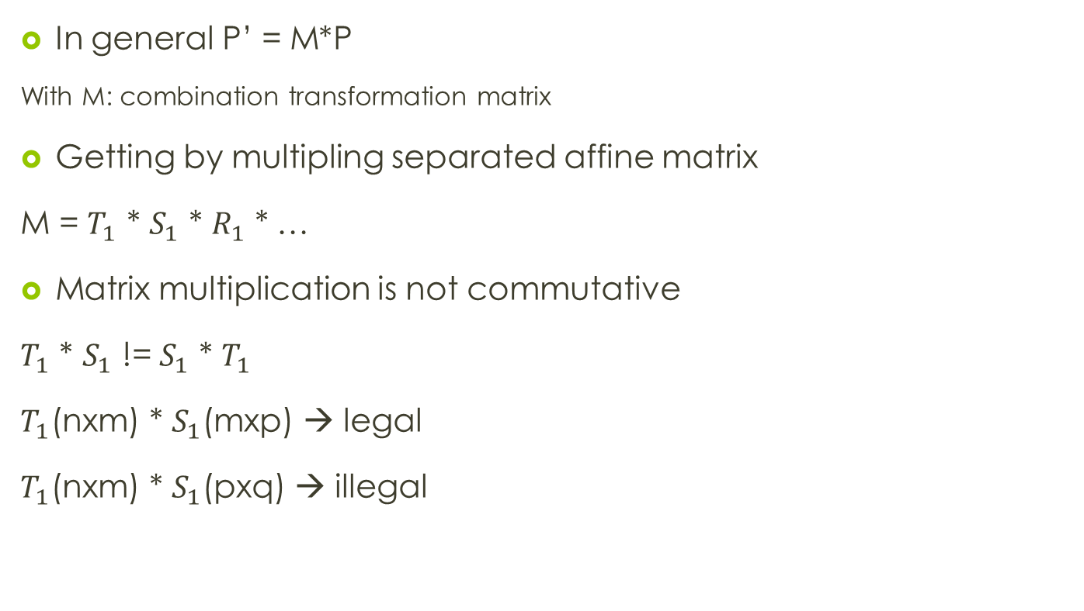
Combine Transformation
In general P’ = M*P
With M: combination transformation matrix
Getting by multipling separated affine matrix
M = $T_{1}$ * $S_{1}$ * $R_{1}$ * …
Matrix multiplication is not commutative
$T_{1}$ * $S_{1}$ != $S_{1}$ * $T_{1}$
$T_{1}$(nxm) * $S_{1}$(mxp) → legal
$T_{1}$(nxm) * $S_{1}$(pxq) → illegal
Notes:
Kết hợp các phép biến đổi (bao gồm 3 phép: xoay, tỉ lệ và tịnh tiến)

Slide 34
Combine Transformation (conts)
Stack of transformation is inverted
Assume we have point P → Translate T → Scale S
P’ = T * P
P’’ = S * P’ = S * T * P = S * T * P

Slide 35
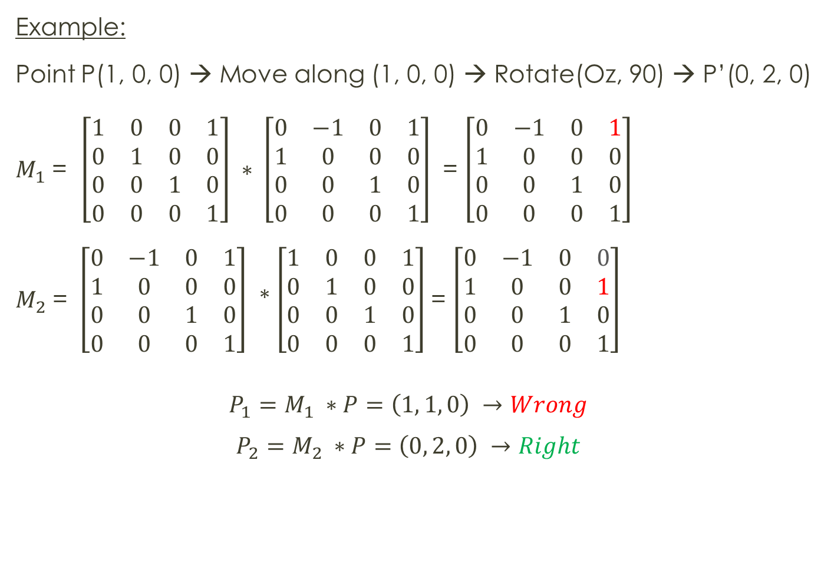
Combine Transformation
Example:
Point P(1, 0, 0) → Move along (1, 0, 0) → Rotate(Oz, 90) → P’(0, 2, 0)
$M_{1}$ = $\left[\begin{matrix}1 & 0 & 0 & 1 \\ 0 & 1 & 0 & 0 \\ 0 & 0 & 1 & 0 \\ 0 & 0 & 0 & 1\end{matrix}\right] ∗ \left[\begin{matrix}0 & −1 & 0 & 1 \\ 1 & 0 & 0 & 0 \\ 0 & 0 & 1 & 0 \\ 0 & 0 & 0 & 1\end{matrix}\right]$ = $\left[\begin{matrix}0 & −1 & 0 & 1 \\ 1 & 0 & 0 & 0 \\ 0 & 0 & 1 & 0 \\ 0 & 0 & 0 & 1\end{matrix}\right]$
$M_{2}$ = $\left[\begin{matrix}0 & −1 & 0 & 1 \\ 1 & 0 & 0 & 0 \\ 0 & 0 & 1 & 0 \\ 0 & 0 & 0 & 1\end{matrix}\right]$ * $\left[\begin{matrix}1 & 0 & 0 & 1 \\ 0 & 1 & 0 & 0 \\ 0 & 0 & 1 & 0 \\ 0 & 0 & 0 & 1\end{matrix}\right]$= $\left[\begin{matrix}0 & −1 & 0 & 0 \\ 1 & 0 & 0 & 1 \\ 0 & 0 & 1 & 0 \\ 0 & 0 & 0 & 1\end{matrix}\right]$
$$P_{1}=M_{1} ∗P=\left(1, 1, 0\right) →Wrong$$
$$P_{2}=M_{2} ∗P=\left(0, 2, 0\right) →Right$$

Slide 36
Practice 5.6
Assume that P(10, -7, 6). Find P’ by
Rotate R(Ox, 90) → Translate T(-10, -1, -6)
Rotate R(Ox, 90) → Translate T(-10, -1, -6) → Rotate R(Ox, 90)
Translate T(10, 1, 6) → Rotate (Ox, 90) → Translate (-10, -1, -6)
Answer?

Slide 37
Content
Introduction
Rendering pipeline
Shader
Basic GLSL-ES
Basic Math
MVP matrices
Textures
Obj model
Shader effect: Skydome using cube mapping

Slide 38
MVP Matrix
What is MVP matrix
Model
View
Projection
Practice
References

Slide 39
MVP Matrix
What is MVP matrix?
MVP matrix is Model View Projection matrix.
MVPMatrix = ProjectionMatrix * ViewMatrix * ModelMatrix

Slide 40
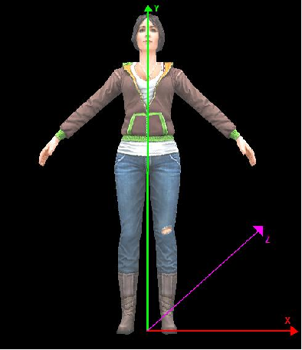
MVP Matrix: Model
Object space
All objects are in the object space, which means they will have the pivot in (0,0,0,1)

Slide 41
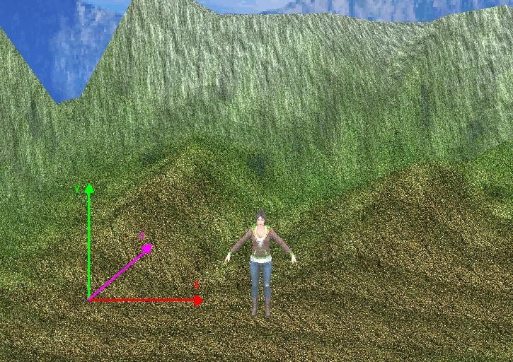
MVP Matrix: Model
Object space in View port
Want to put objects at desired location in 3D world?
→ Appropriated scale, translate and rotation!
To bring object from local space to work space:
World Matrix * Object

Slide 42
MVP Matrix: View
Rotate Camera vs Rotate Object:
Notes:
Cách chuyển động của camera và objects là 2 cach chuyển động ngược nhau.

Slide 43
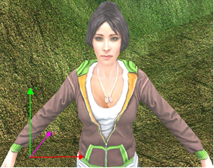
MVP Matrix: View
Want to move all objects as little as possible?
→ Need Camera
Camera object has its own world matrix.
To make the world be relative to the camera's location called View Matrix → multiply the object with the inverse of the camera's world matrix (View Matrix)
Now is:
View Matrix * World Matrix * Object

Slide 44
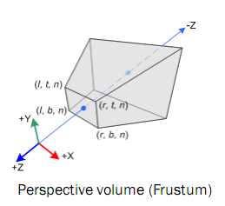
MVP Matrix: Projection
2 ways to define frustum (perspective projection volume)
6 planes of frustum
FOV + nearPlan + farPlan
◆ 6 planes of frustum (left, right, near, far, top, bottom)
Near Plane: any geometry closer
to the camera will be clipped.
Far Plane : any geometry beyond
this plane will be clipped.

Slide 45
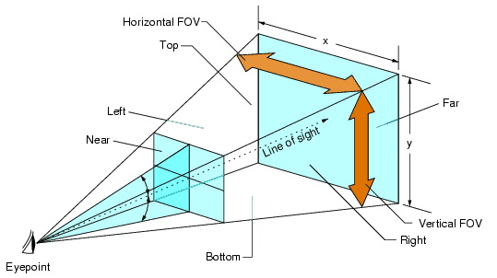

MVP Matrix: Projection (conts)
❖ FOV (fovy, aspect, near, far)
Ex: FOV (45, $4/3$, 1, 10000)
Fovy: the camera will open 45 x 2= 90 degrees
Aspect: All images display with aspect ratio is ${SCREEN_WIDTH}/{SCREEN_HEIGHT}$ of render screen

Slide 46
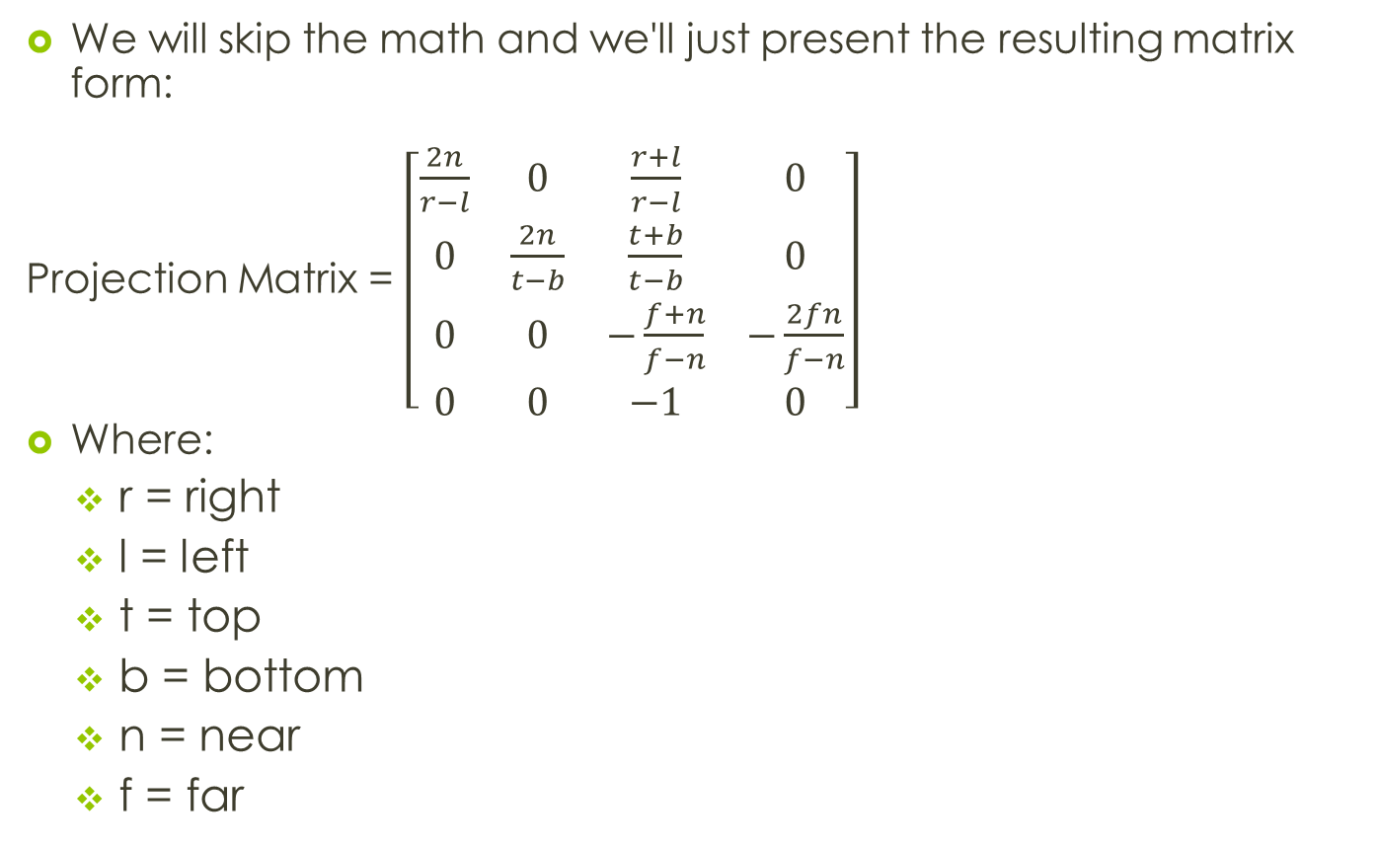
MVP Matrix: Perspective Projection
We will skip the math and we'll just present the resulting matrix form:
Projection Matrix = $\left[\begin{matrix}\frac{2n}{r−l} & 0 & \frac{r+l}{r−l} & 0 \\ 0 & \frac{2n}{t−b} & \frac{t+b}{t−b} & 0 \\ 0 & 0 & −\frac{f+n}{f−n} & −\frac{2fn}{f−n} \\ 0 & 0 & −1 & 0\end{matrix}\right]$
Where:
r = right
l = left
t = top
b = bottom
n = near
f = far
Now is:
Projection Matrix * View Matrix * World Matrix * Object
Notes:
Ma trận để implement phép chiếu phối cảnh

Slide 47
MVP Matrix
Finally, formula to render a scene with regards to the viewpoint (camera) and the perspective projection:
In a right handed coordinate system, transposed matrix:
Final(x,y,z,w) = ProjMatrix*ViewMatrix*WorldMatrix*Initial(x,y,z,w);
Notice that all the matrices have to be changed accordingly
The final position will be in Homogenous Clip space

Slide 48
MVP Matrix: Coding
GLint mvpMatrixLoc = glGetUniformLocation(programHandle,"u_mvpMatrix");
Matrix maProjection, maView, maModel; //Matrix is declared by 2 dimensions array
The value of matrix???
Matrix maMvpMatrix = m_maProjection * m_maView * m_maModel;
maMvpMatrix.MakeTranspose(); //transpose matrix
float *fMvpMatrix = maMvpMatrix.ToArray(); // convert to 1 dimension array
glUniformMatrix4fv(mvpMatrixLoc, 1, GL_FALSE, fMvpMatrix );
…
glVertexAttribPointer(…);
glDrawArrays ( GL_TRIANGLES, …);

Slide 49

MVP Matrix: Practice
Assume triangle $\left\{\begin{matrix}0.0f & 0.0f & 0.0f \\ 0.0f & 4.0 f & 0.0f \\ 4.0f & 3.0f & 0.0f\end{matrix}\right\}$
Find P’ in 3D world of Opengl coordination system?

Slide 50
References
http://www.songho.ca

